Slide 1
COVID-19 Growth Impacts
A look at the growth trends of SARS-CoV-2
Alex Rhomberg, Tyler Alfirevic, Quinn Mettert, Erik Edminster
Notes:
Our project covered the growth impacts of COVID-19 and looked at various elements that have impacted it recent surge throughout the United States and specifically the midwest.

Slide 2
Agenda
Our Findings
The Methods
Conclusion
Weather
Expected Cases
Infection Rate and Spread
How we found the data
Programs we used
Analysis Processes
What’s next?
Call to Action
Questions
Notes:
Today we will cover three aspects of our research, our findings, the methods we used, and the conclusion we made.

Slide 3
The Findings
What we found
Notes:
These are the findings and what we found.

Slide 4
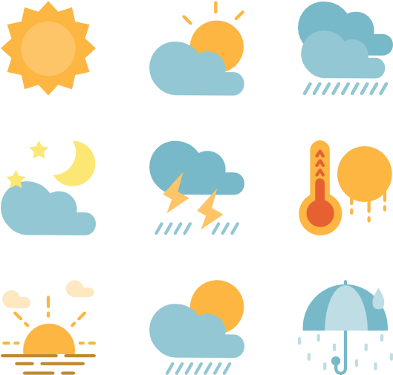
COVID-19 vs Weather
A look at the growth rates compared to weather trends

Slide 5
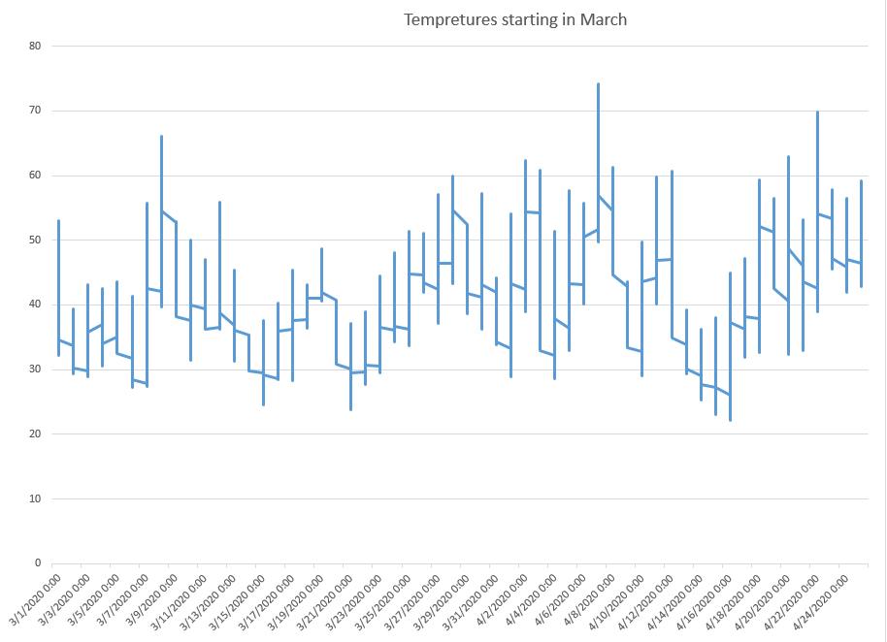
Notes:
This graph represents each day from March 1st - April 24th with the temperature for each day. The graph shows the low and high for each day and where the temperature starts when the line crosses over. The temperature has been very consistent throughout the two months we based it off of.

Slide 6
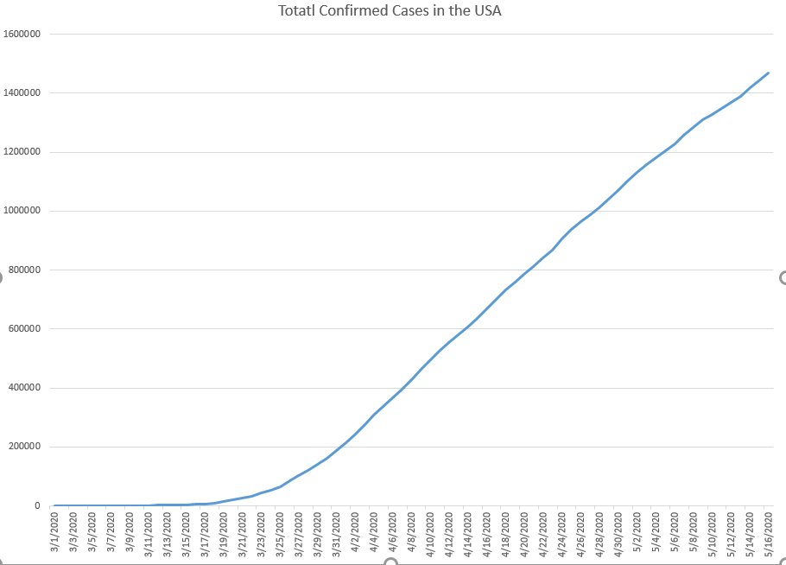
Notes:
This graph is representing the amount of confirmed cases starting in March all the way up to date. It really starts to show growth at the start of April and the slope continues to go up into May. It is starting to slow down though towards current day with the precautions that were taken.

Slide 7
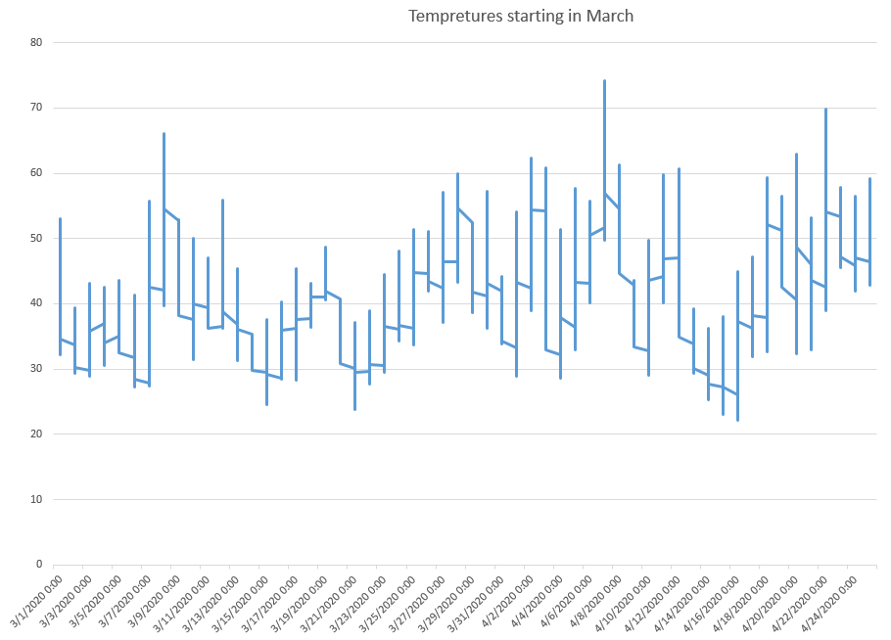
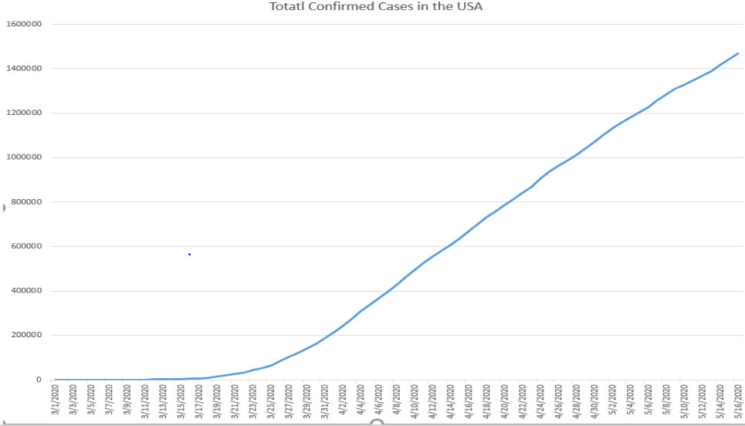
Notes:
Here are the two graphs side by side with how the temperature could relate to the increase in cases. They correlate by it starts to get warming and the cases continue to go up, but they are starting to round off as well.

Slide 8

COVID-19 vs Expected Cases (IA)
A look at the expected cases based on deaths

Slide 9
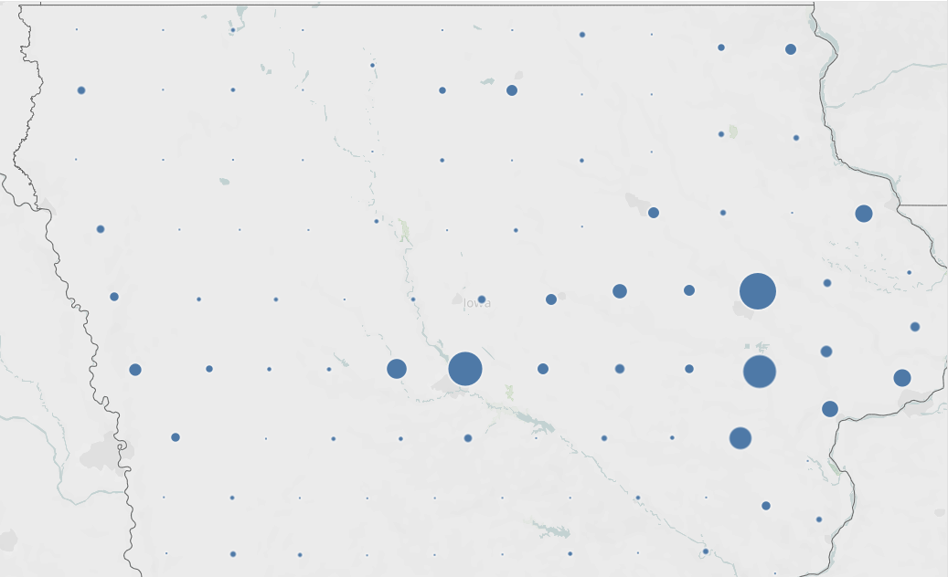
April 1, 2020
Notes:
Here we have the confirmed cases within Iowa by county on April 1. The size of each bubble represents the number of cases for that particular county.

Slide 10
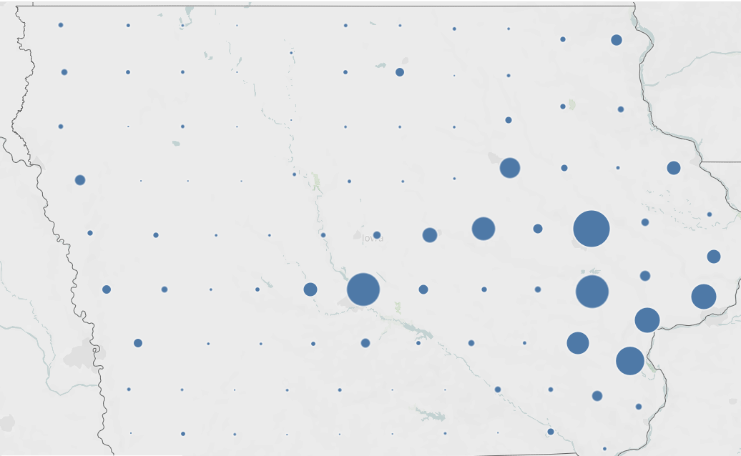
April 15, 2020
Notes:
Iowa did not see many confirmed cases until April, and this is where it started to have an exponential spread. Mid April saw double the amount of cases in comparison to the first of the month.

Slide 11
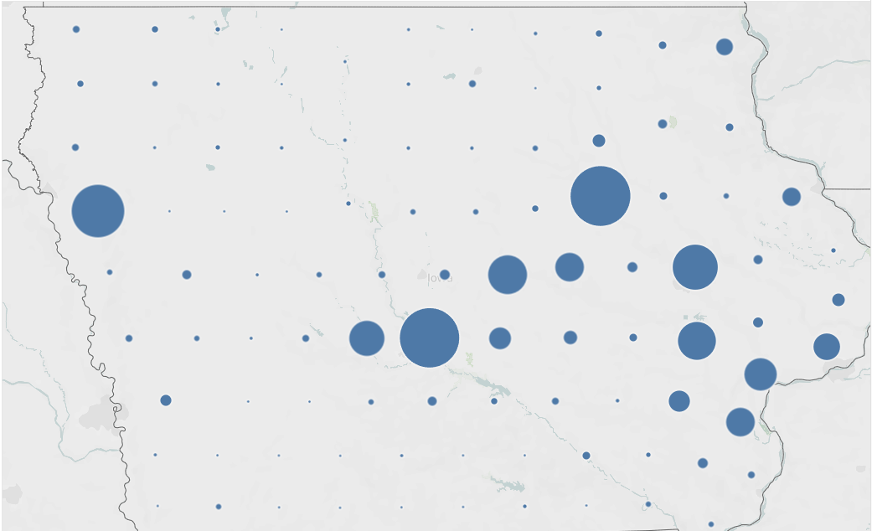
May 1, 2020
Notes:
The beginning of may saw even more growth, and this trend has continued through the midway point of the month as well. The counties with bigger towns saw the most amount of cases.

Slide 12
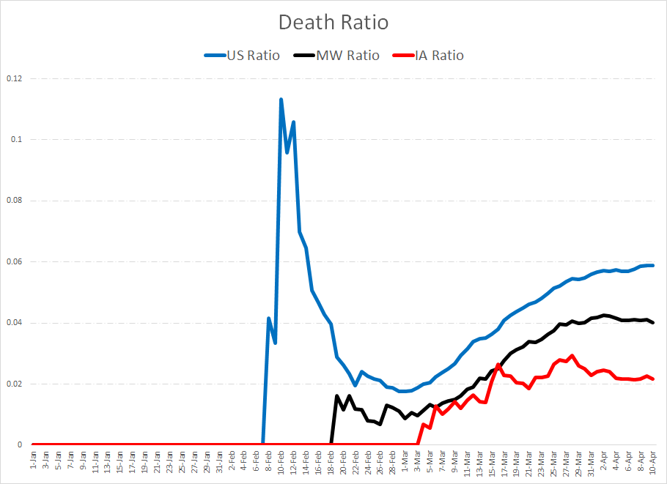
Are people dying?
Notes:
To simply answer, yes people are dying, and they are dying at a higher rate than we might have expected or even want. This chart shows the death rate over time for the United States as a whole, the Midwest, and for Iowa.The United States as a whole saw a very large death rate early on as we were not prepared like most other countries. As time went on, we gained a greater control, but the death rate has continued to rise as a result of growing cases. Not many countries are equipped to handle an outbreak of this size, and it is starting to show with the rising death rates, especially within the United States.

Slide 13
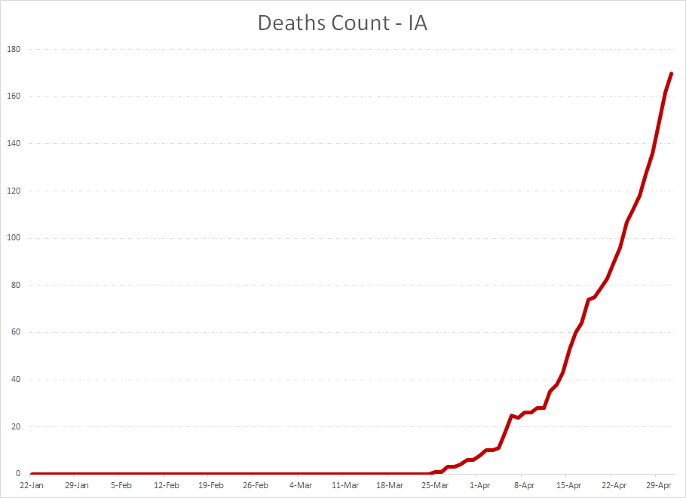
Notes:
This chart shows that within Iowa, people are dying, and they are dying at an exponential rate.The big problem with COVID-19 and why it's so deadly is because there is a great series interval (of an average of 5 days) from when a person contracts the virus and starts to show symptoms. This has made the rate of infection so high because people feel fine, but instead they are passing the disease on to others before they even know it. More people being infected means more people dying. However, we can prepare for these grand numbers of infections by predicting how many people might have the disease at a certain time based on the amount of deaths in that area. This way, measures can be taken ahead of time before it is too late.

Slide 14
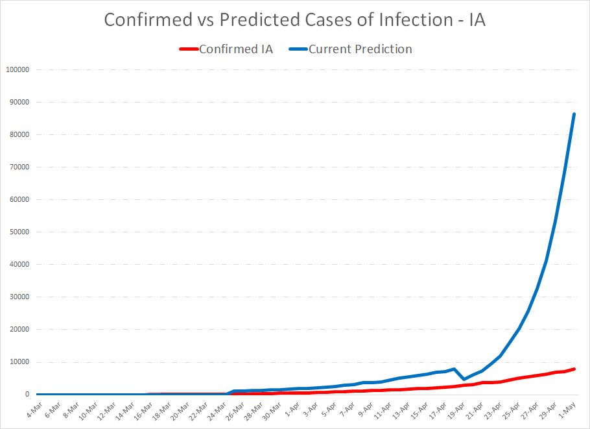
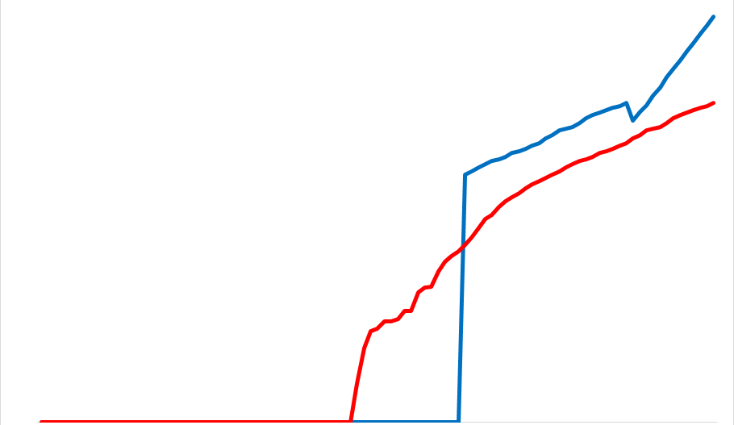
What are the predicted cases?
The logarithmic scale is pictured below.
Notes:
Using a method which I will go into greater detail on later, we were able to show a comparison of the amount of current confirmed cases in Iowa and how many cases we predict there to actually be. The bottom right hand chart shows a logarithmic scale for this who are interested in looking for ‘the flat line turn’ as they say. We can see that cases are shooting up exponentially and as of May 1st, we predicted there could be roughly 87,000 people with the disease in comparison to the less than 10,000 who actually tested positive for it. This is quite alarming and really should be used to emphasize the importance of social distancing and always being careful when coming in contact with others.

Slide 15
COVID-19 vs Social Distancing
A look at the R0 value trends

Slide 16
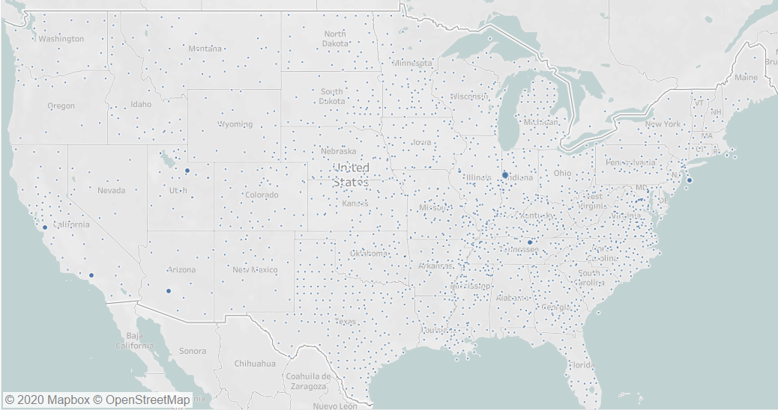
February 1, 2020
Notes:
Here we have the number of confirmed cases over the entire United States on February 1st. There are a few locations (which I circled) across the U.S. that stood out a little more compared to the others which we assume were more dense, highly populated areas which lead to more confirmed cases at this period of time.

Slide 17
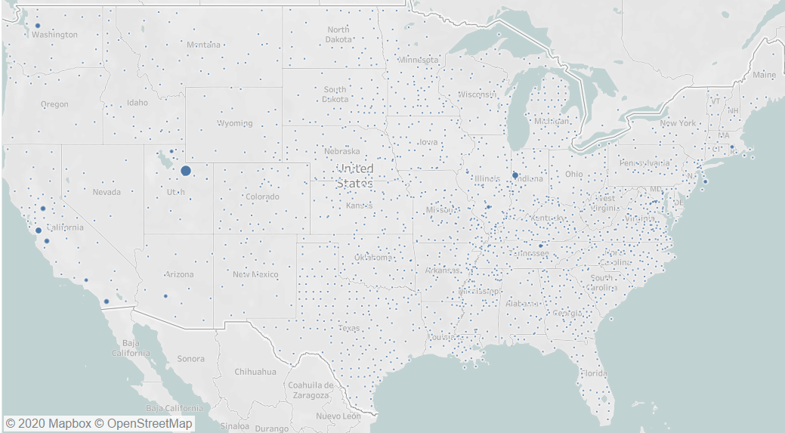
March 1, 2020
Notes:
Here we have the number of confirmed cases in the United States on March 1st. As you can see, a few location I had circled seemed to have grown in size over the last month. A few larger dots appeared in California and the one in Utah grew in size. It doesn’t seem like many other places had too significant of an increase from February to March.

Slide 18
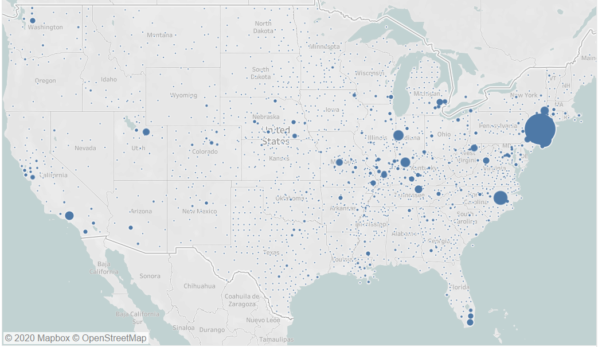
April 1, 2020
Notes:
April is really where things started to blow up. As you can see in the Midwestern and Eastern states there was a substantial increase in the number of confirmed cases, especially in the New Jersey/New York area. California seemed to have a bit of an increase as well, but comparatively it was not as large.

Slide 19
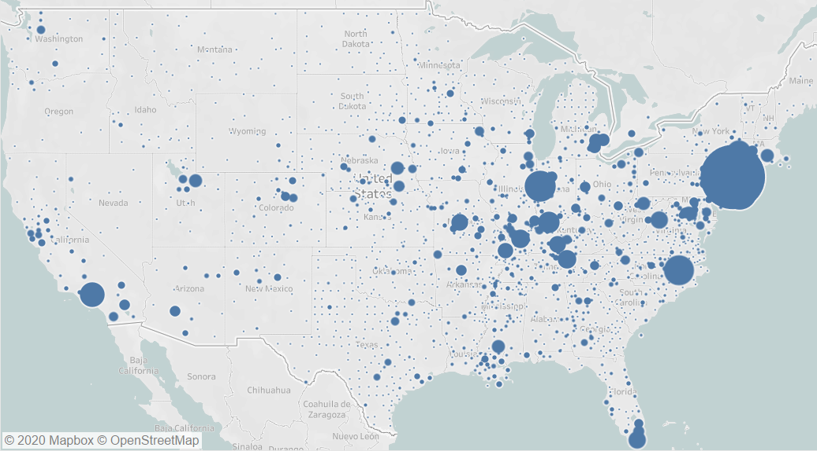
May 1, 2020
Notes:
In this map we can see that in the month of May the United States got hit HARD. Our Midwestern and Eastern states now devastated by COVID and a plethora of confirmed cases in the the matter of a month. When looking at the time frame (February-May) we can see just how fast this virus can spread, especially when narrowing on the last two months. Many other states that were not impacted as hard in the early months, Texas, Nebraska, Colorado, are now seeing pretty large increases as well. Luckily for a few states, Montana, North Dakota, Nevada, they didn’t seem to be impacted too heavily whatsoever, which leaves us with many possible questions as to why that is and also raises questions as to what factors played a part in the states that are being decimated by the virus.

Slide 20
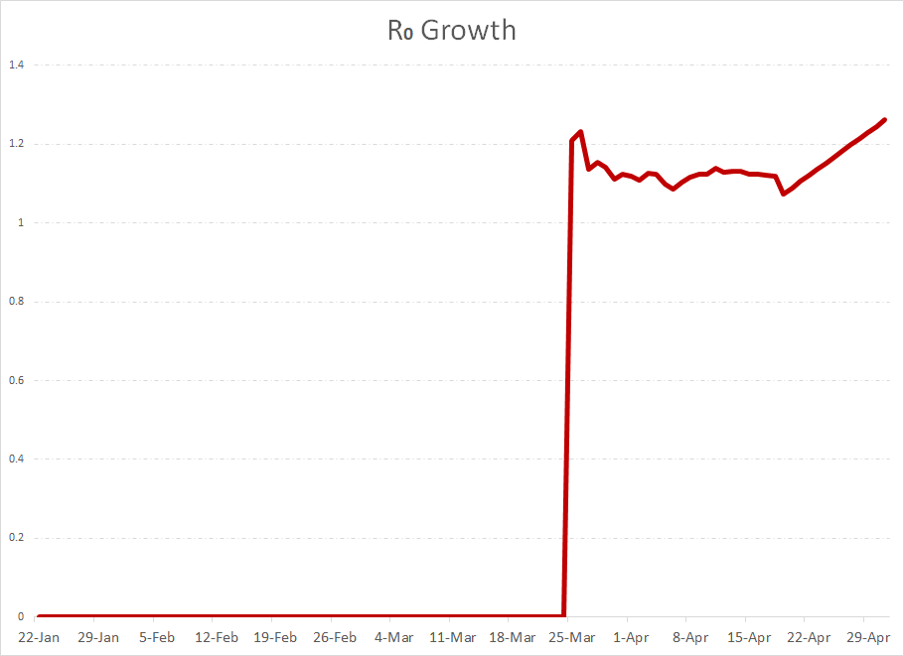
Notes:
This is just a simple line graph to represent the rate of infection in the state of Iowa over a certain time period (January 22nd - May 1st). The R0 value is essentially a representation of how many other people, will someone who is infected, also infect. With the Y-axis being the infection rate and the X-axis being our dates over the time period, we can see that there was an incredible spike right around March 25th. From then to the month of May we see the R0 value fluctuating up and down; we can likely assume that these decreases can be credited the social distancing orders that have been put in place, however, it seems like towards to the end of April into the beginning of May we see a constant increase in the rate of infection.

Slide 21
The Methods
How we analyzed the data
Notes:
These are the methods that we used for analyzing the data and creating visuals.

Slide 22
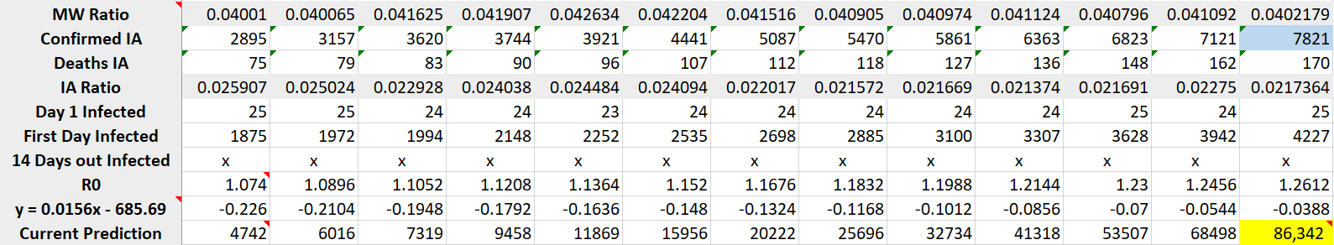
Case Predictions
Data sourced from John Hopkins University.
Average of 14 days from infection until death.
Use death rate of a region to predict how many cases currently exist based on current deaths.
R0 (rate of infection) can be found by looking at past data and using linear regression to predict the future.
Prediction as of May 1st was 86,342 people could potentially have it.
Notes:
For the case predictions, all of the data was sourced from John Hopkins University, specifically their github repository. Below is a table of totals that I made for each day of data that I was able to use to make the case predictions. The process here was to look at how many days on average it took before a person died when contracting the disease, and how many people could have been exposed during this time frame. The ratios at the top are the death ratios for the midwest and Iowa. The day 1 infected shows how many people could have been infected at the same time as the one person's death based on the death ratio. First day infected simply multiplies the day 1 infected by the number of deaths that occured on that day. Looking at the data, you can use 14 day intervals to compute the R0 value, or rate of infection. I then took this and graphed it to see if there was a linear trend, which there was. I then used this to predict the R0 value for the previous 13 days before May 1st and ultimately make a more accurate prediction of COVID-19 cases (highlighted in yellow bottom right). The number is ultimately calculated using the rate of infection information and how many people might have had it on the first day, and using the 14 day interval from infection to death to simulate growth.

Slide 23
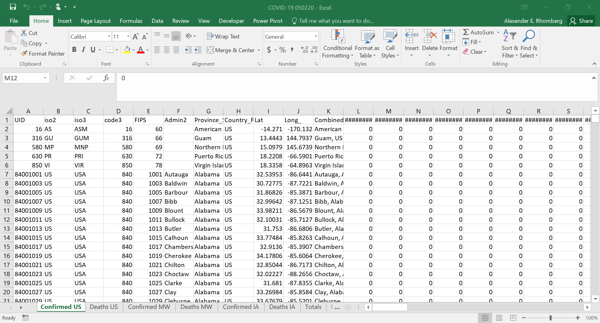
Notes:
This is what the raw data looked like when opening the .csv file from John Hopkins. There wasn’t much cleansing that had to be done, but data was pulled from the master for more analysis as seen on the previous slide.

Slide 24
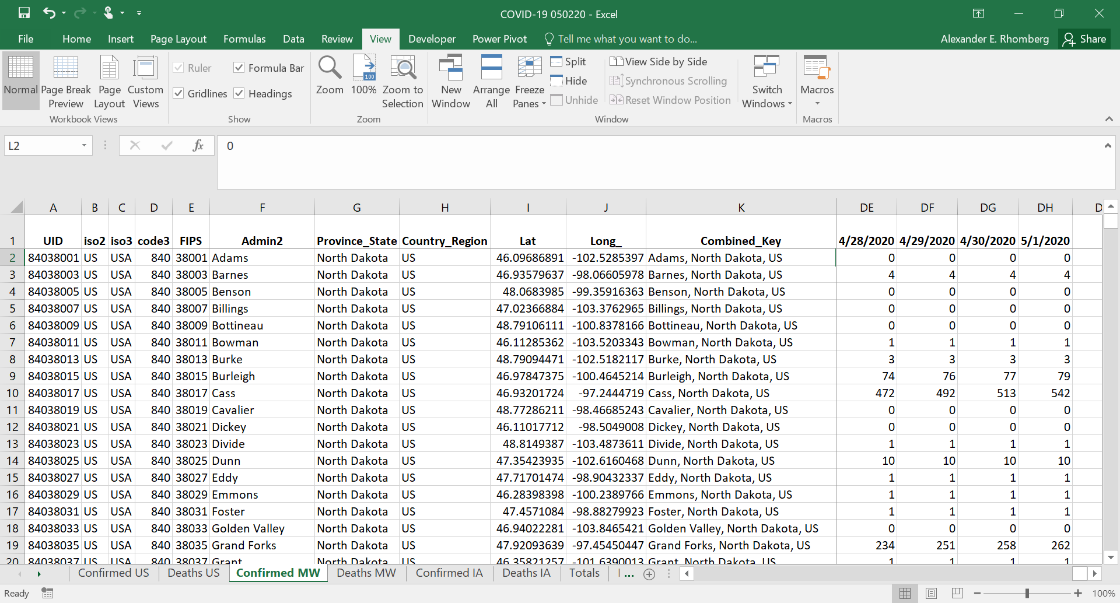
Notes:
Here is what some of the data looked like cleaned up with a combination of the midwestern states that I compiled.

Slide 25
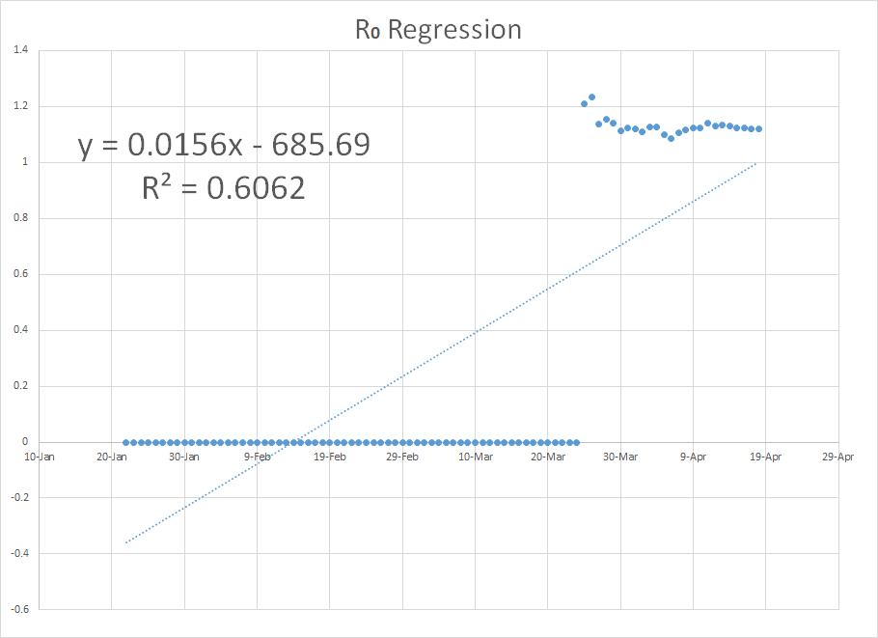
Notes:
This is the linear trend that was used during the rate of infection prediction. I used excel to do this analysis.

Slide 26
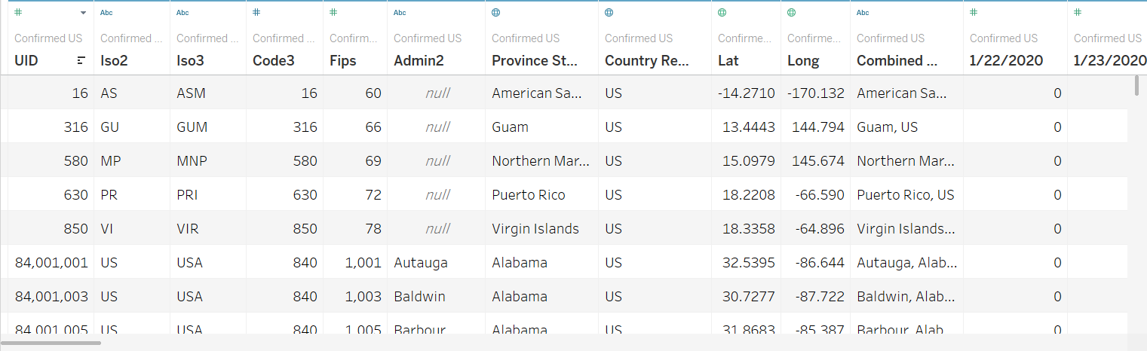
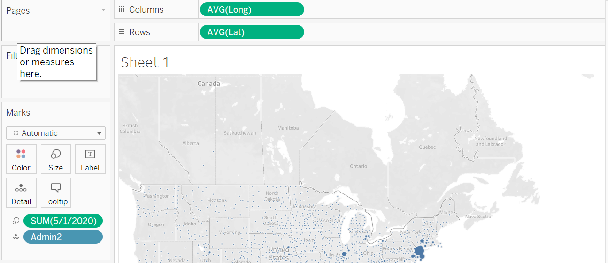
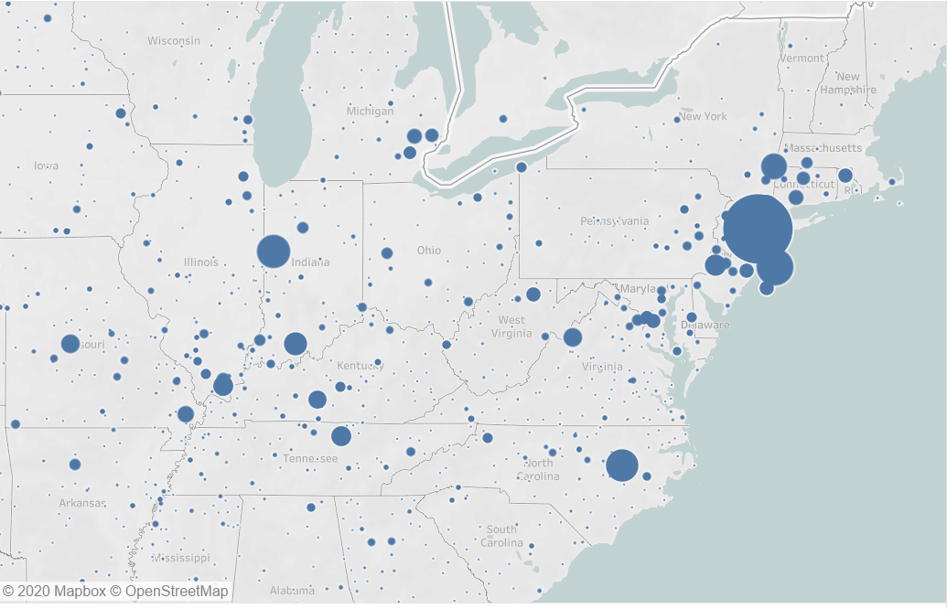
Notes:
This is what the data looked like in Tableau, which was used to create the map visuals. The variables along the top were adjusted to be used for various purposes, geographical, numerical, etc. This made it easy for creating the visual in tableau with the drag and drop features.

Slide 27
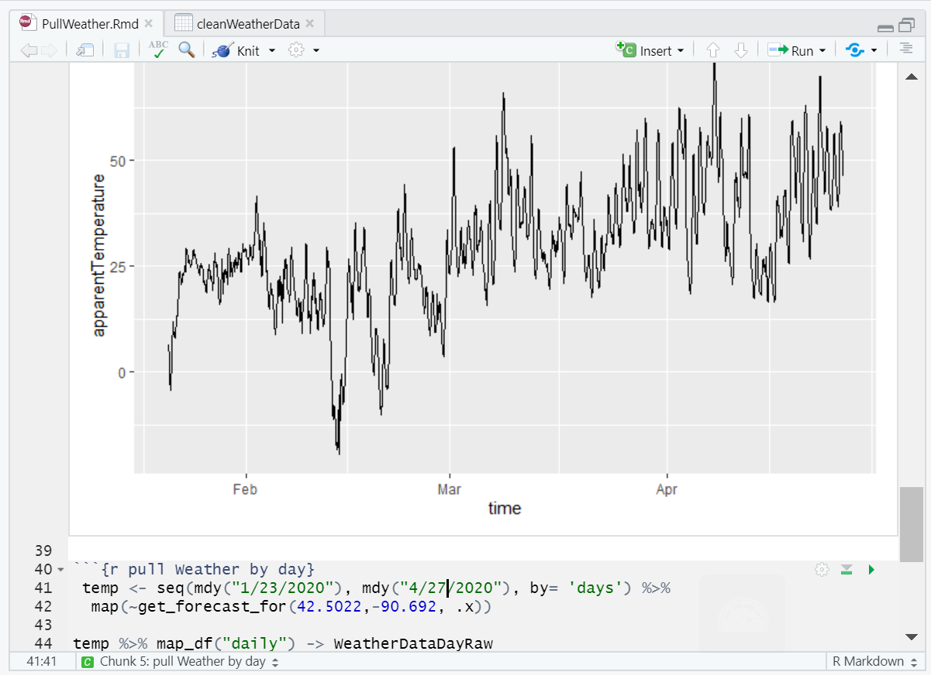
Notes:
R was used to pull in the weather data from Dark Sky. From here it was formatted as a data table and exported to a .csv file. This is a snapshot of some of the code from the R script.

Slide 28

Conclusion

Slide 29
Weather
Our findings show that for the confirmed number of covid-19 cases gradually rises and really never spikes at any given time, it's just a continuous upward sloping line that really hasn't peaked yet
As for the weather, this graph shows the highs and lows of the weather for each day, and what we see on this graph is that its all over the place and not steady like the confirmed covid-19 cases graph
By comparing the two graphs, we concluded that there wasn't a correlation between the weather and confirmed cases. We made this conclusion based off the movement and direction of which each graph was headed in and with the confirmed cases graph going continuously up and the weather graph going up and down constantly, we saw there was no correlation.

Slide 30
Case Predictions
Using the case prediction model gives a good glimpse of what is really out there.
Our findings show the importance of social distancing because of the great series interval COVID-19 has.
If there were more social distancing rules in place, the cases wouldn’t be growing exponentially, even though things seem fine.
With this information, we would hope a greater emphasis is placed on social distancing.
We all want this to be over, but if we keep on spreading the disease around, it will never end until there is a vaccine.

Slide 31
Rate of Infection
The visualizations used for the cases confirmed in America gives us a nice visual representation of how quickly this virus can spread.
Our findings in this area also show the important role that social distancing plays in slowing the spread.
The end of the R0 Growth visualization raises slight concern as we start to see a steady increase of confirmed cases in Iowa along with an increase in our R0 value.
We could possibly explore more into the amount of testing Iowa has done to see if this is the cause in a rise of cases.

Slide 32
Questions?
Notes:
This is the slide we would have used to allow for questions.

Slide 33
Thank You

